Slide 1
Music Recommendation System
RANJEETA
ISHA MUGHAL
JHANZEB
SUBMITTED TO : SIR SHER DAUDPOTA

Slide 2
CONTENT
Introduction
Methodology
Dataset Discussion
Major Outcomes
Working of Project
Conclusion

Slide 3
INTRODUCTION
Why recommendation system?
Content Based Filtering
Collaborative Filtering
Music Recommendation System.

Slide 4
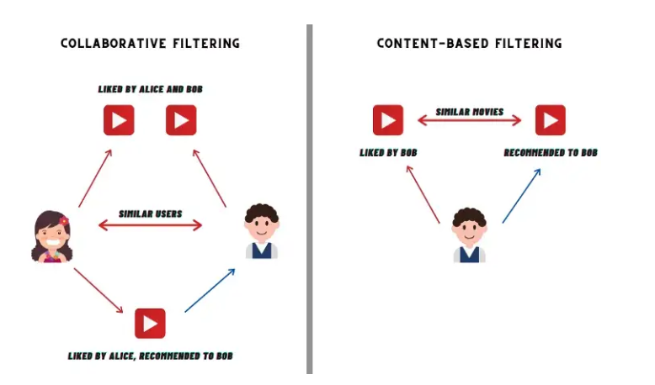

Slide 5
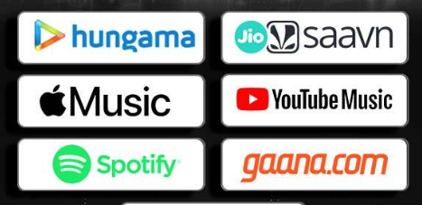
APPLICATIONS

Slide 6
METHODOLOGY
Methodology
K-means
Clustering
Assigning Web Interface
Deployment
Preprocessing
Preprocessing
Data Exploration
Data Transformation
Remove columns
K-means Clustering
Assigning a Web Interface
Deployment using flask.

Slide 7
DATASET
Spotify dataset collected from spotify.
It contains over 175,000 rows and 19 features
It contain audio Features as well as info features.
Dataset Link:
https://drive.google.com/file/d/1it3VAYze6nChmaxPHF3QLJcvoZhMsemQ/view

Slide 8
MAJOR OUTCOMES
Time saving system.
Recommend songs as many as user want
Help you to not get confuse.
A web based interface for user ease.

Slide 9
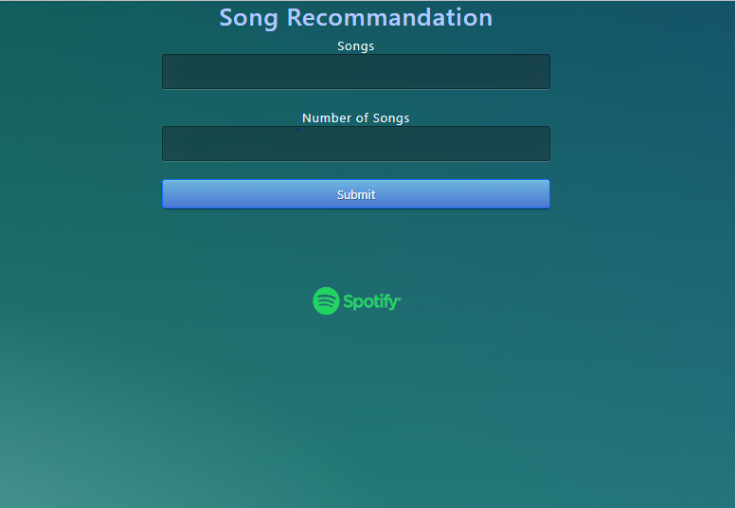
WORKING OF PROJECT
This is the initial page of our app in which we ask a user for enter song and the number of song.

Slide 10
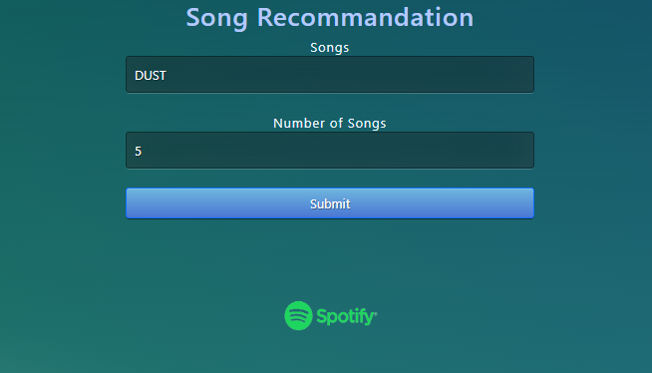
WORKING OF PROJECT
Where you type the current song.

Slide 11
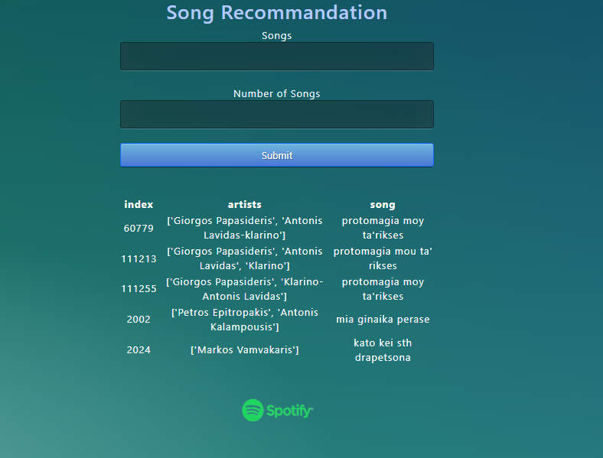
WORKING OF PROJECT
This is the 3rd screen where the output is printed using flask table.

Slide 12
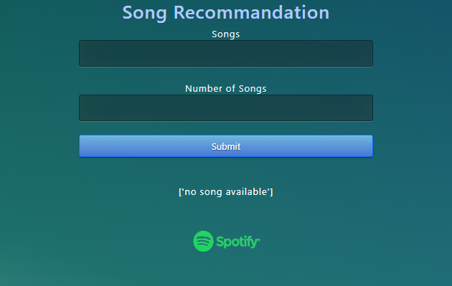
WORKING OF PROJECT
When you search for the song which is not available in dataset it will show song is not available.

Slide 13
CONCLUSION
Introducing content based recommendation system. A recommendation system is what helps a streaming application in providing a good user experience
Our model will predict and offer the number of songs you want, By using music recommender system, the music provider can predict and then offer the appropriate songs to their users based on the characteristics of the music that has been heard previously.

